Slide 1
Understanding Factor Analysis
Presented by
Dr. J. P. Verma
Professor(Statistics)
Head, Department of Sport Psychology
MSc (Statistics), PhD, MA(Psychology), Masters(Computer Application)
Email: vermajprakash@gmail.com
web: jpverma.org
Lakshmibai National Institute of Physical Education, Gwalior, India
(Deemed University)
Govt. of India, Ministry of Youth Affairs and Sports

Slide 2
Principal Component Analysis
/Factor Analysis
Comprise family of exploratory data analysis
Principal Component Analysis (PCA)
Factor Analysis(FA)
Data reduction technique
Identify small number of dimensions underlying a relatively large number of dimensions
Karl Pearson(1901),
Charles Spearman (1904)
Harold Holding(1933,1936)
Study the latent structure in given set of variables
Identify small number of constructs dispersed among several variables
Louis L Thurstone(1931,1935)

Slide 3
Principal Component Analysis
A linear Combination of variables
Purpose
Data reduction
Easy interpretability
How it helps
PCA can be used to discuss important characteristics of a large dataset.
Helps in detecting relationships that were previously not seen
Application
In social science, market research, sports etc., that use large datasets.
PCA can be used to reduce number of variables and solid multicollinearity

Slide 4
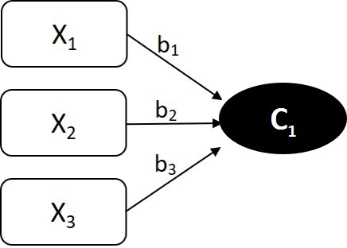
PCA Model
C₁ = a₁x₁ + a₂x₂ + a₃x₃ + ……. a_{n}x_{n}
Factors like
Strength and Power
Endurance
Agility and speed
Figure 1 PCA Model of forming component
Example: To develop a talent identification criteria for graduate athletes on the basis of the six physical fitness variables from 100 athletes
50 mt. (sec) - speed SBJ(cm) – Explosive power
Sit-ups (1 min)- Core muscular endurance Push-ups (1 min) – Upper body Strength
VO2 Max(ml/kg/min. Illinois Agility test- Agility & Coordination
Objective: To reduce these 6 variables into fewer dimensions for:
Athlete profiling
Creating selection indices
Visualization and comparison
After PCA can be reduced to three components
PC1 55% Overall Physical Fitness
PC2 25% Speed-Agility Dimension
PC3+ 20% Minor uncorrelated components

Slide 5
Factor Analysis
Measurement model of a Latent variable
Two Types: Exploratory and confirmatory factor analysis
Purpose
To unfold the latent structure in a given set of variables.
Used when no dependent variable is available
Analyse structure of the interrelationships among the large number of variables
Presumption
Some factors explain the shared variance among the set of observed variables
Focus
Looks for few latent variables known as factors that can explain interrelations among observed variables

Slide 6
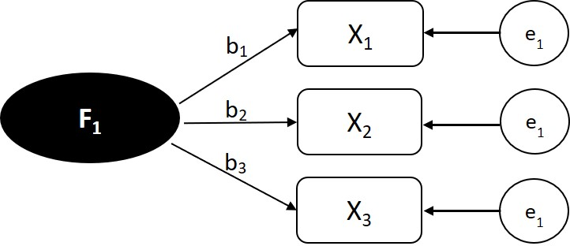
Factor Analysis Model
Factors are assumed to cause the observed variables rather linear combination of them
X₁= b₁F₁+e₁
X₂= b₂F₂+e₂
X₃= b₃F₂+e₃
Objective: To identify underlying physical fitness components in adolescent athletes using several test scores
Figure 2. Factor Analysis model for forming factor
100-meter sprint time (speed)
Standing broad jump (explosive leg strength)
12-minute run (endurance)
Sit-ups in 1 minute (abdominal strength)
Sit-and-reach test (flexibility)
Handgrip strength (arm strength)
Vertical jump (power)
Shuttle run (agility)
FA may identify broad dimensions
Variable | Factor 1: Strength & Power (Force) | Factor 2: Endurance (Stamina) | Factor 3: Agility & Speed (Quickness)
Standing broad jump | 0.82 | 0.10 | 0.18
Sit-ups | 0.78 | 0.12 | 0.14
Handgrip strength | 0.75 | 0.05 | 0.10
Vertical jump | 0.70 | 0.20 | 0.25
12-minute run | 0.12 | 0.83 | 0.09
Sit-and-reach | 0.20 | 0.15 | 0.05
Shuttle run | 0.30 | 0.08 | 0.76
100-meter sprint | 0.25 | 0.12 | 0.81

Slide 7
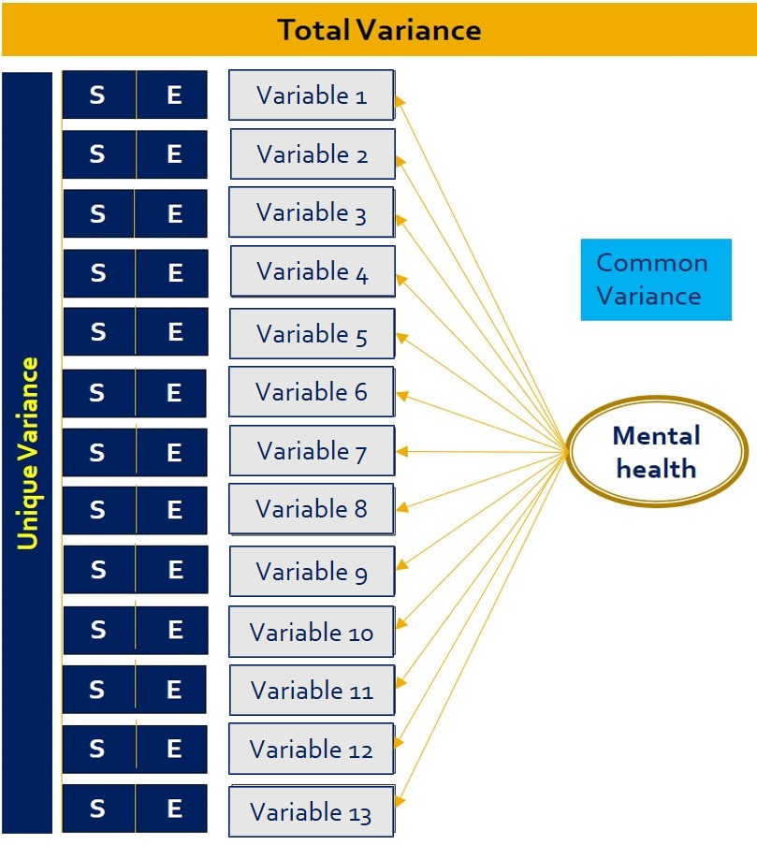

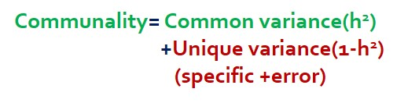
Partitioning of Variance in PCA and Factor Analysis
In PCA
In Factor Analysis
Since in PCA there is no unique variance hence
Communality = h² = 1

Slide 8
Assumptions in PCA/FA
SN Assumptions How to test Threshold
1 Sample Size should be adequate KMO test 0.7 or more
2 Correlation matrix is not unity Bartlett’s test of sphericity p<.05
Compute Determinant of should be positive
correlations

Slide 9
How Components /Factors are made in PCA/FA
Using matrix of correlation
Mutual goal
To account for the variance in the matrix by series of weighted linear functions (components or factor)

Slide 10
PCA/Factor Analysis
Composed of two phases
PCA
Factor Analysis
1. Extraction
Principal component
Principal Axis factoring
Maximum likelihood
Unweighted
Generalized least squares
Orthogonal
Oblique
2. Rotation
(Keeps the dimensions orthogonal)
(Allows the angle between oblique)
Variamax
Promax
Equamax
Direct oblimin
Quartimax
[factors to be uncorrelated
after rotation]
[factors to be correlated
after rotation]
Remark: In PCA/FA most of the variables correlate most strongly with the first component or factor

Slide 11
Characteristics of dimensions in PCA/FA
Dimensions are extracted sequentially
First factor extracts maximum variance with subsequent reduction.
Dimensions are Independent to each other (orthogonal)
Explained variances are additive in nature due to orthogonality
First few components/factors will together accounts for relatively large percentage of variance
Provide J shape (scree plot) by plotting Y-axis(Eigen value) vs X-axis(number of components/factors

Slide 12
Goal of the Researcher in PCA/FA
Select minimum number of components/factor explaining maximum amount of variance for rotating
So that component/factor structure can be meaningfully interpreted
After extraction phase it is assumed that the components/factors intersects at 90⁰ angle.

Slide 13
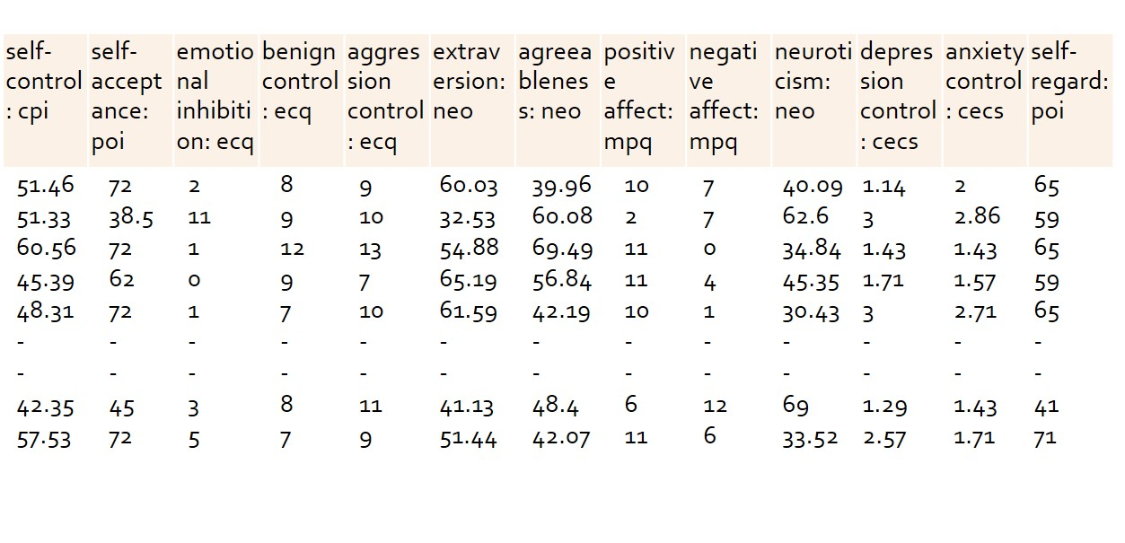
Factor Analysis – An Illustration
Illustration:
To study the component/factor structure in personality measures of a population
425 cases

Slide 14
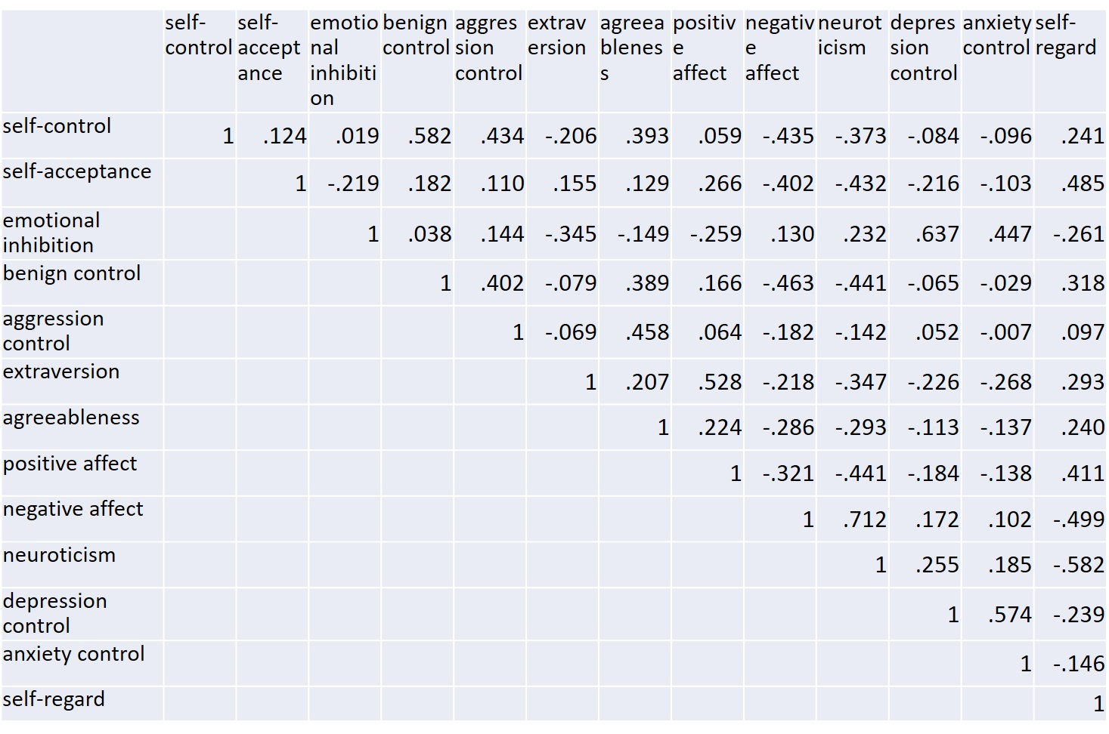
Correlation Matrix
Couple of higher correlations
If not removed may turn out to be artificial researcher created factor
Let us first do PCA by retaining all variables
Each variable contribute 1 unit to the total variance. Thus, total variance is 13.

Slide 15
Descriptive Statistics
_________________________________________________ Mean SD N
_________________________________________________
self-control: cpi 47.0723 8.92148 419
self-acceptance: poi 53.8294 12.14851 419
emotional inhibition: ecq 4.9618 2.97573 419
benign control: ecq 7.9642 2.81591 419
aggression control: ecq 8.4344 2.91217 419
extraversion: neo 55.8388 11.29538 419
agreeableness: neo 47.9305 11.96092 419
positive affect: mpq 7.7017 2.91248 419
negative affect: mpq 5.7613 3.71797 419
neuroticism: neo 50.5110 11.14605 419
depression control: cecs 2.1626 .64635 419
anxiety control: cecs 2.2542 .68142 419
self-regard: poi 55.3437 10.48484 419
_________________________________________________
Six cases due to incomplete data removed
KMO and Bartlett's Test
Kaiser-Meyer-Olkin Measure of Sampling Adequacy. .798
Bartlett's Test of Sphericity Approx. Chi-Square 2.072E3
df 78
Sig. .000
KMO greater than .7 indicate sample adequacy
Significance of Bartlett’s test indicates correlation matrix is not identity

Slide 16
Unrotated Solution in PCA
Total Variance Explained
Component | Initial Eigenvalues |  |  | Extraction Sums of Squared Loadings
 | Total | % of Variance | Cumulative % | Total | % of Variance | Cumulative %
1 | 4.106 | 31.587 | 31.587 | 4.106 | 31.587 | 31.587
2 | 2.351 | 18.084 | 49.670 | 2.351 | 18.084 | 49.670
3 | 1.426 | 10.966 | 60.637 | 1.426 | 10.966 | 60.637
4 | 1.095 | 8.422 | 69.058 | 1.095 | 8.422 | 69.058
5 | .758 | 5.829 | 74.888
6 | .573 | 4.406 | 79.294
7 | .537 | 4.131 | 83.424
8 | .468 | 3.599 | 87.023
9 | .414 | 3.187 | 90.211
10 | .406 | 3.121 | 93.332
11 | .318 | 2.447 | 95.779
12 | .286 | 2.197 | 97.975
13 | .263 | 2.025 | 100.000
Total=13
(4.106/13) =31.587
Extraction Method: Principal Component Analysis
Remark: Initial Eigen values is initial analysis which is a PCA even if you do factor analysis

Slide 17
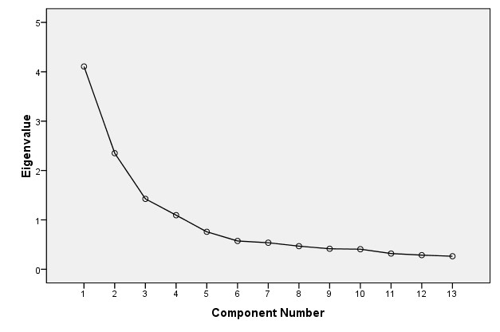
Scree Plot
Substantial gain in explained variance through three components so retain at least the first three components
We may include fourth component depending upon how the rotated components are to be interpreted.

Slide 18
Communalities
__________________________________________
Initial Extraction(h²)
self-control: cpi 1.000 .732
self-acceptance: poi 1.000 .518
emotional inhibition: ecq 1.000 .698
benign control: ecq 1.000 .656
aggression control: ecq 1.000 .647
extraversion: neo 1.000 .808
agreeableness: neo 1.000 .704
positive affect: mpq 1.000 .671
negative affect: mpq 1.000 .693
neuroticism: neo 1.000 .746
depression control: cecs 1.000 .797
anxiety control: cecs 1.000 .674
self-regard: poi 1.000 .633
_________________________________________
Extraction Method: Principal Component Analysis.
Communality
Amount of variability in the variable explained by all the extracted factors together
Remark: Drop variable if communality is .4 or less

Slide 19
Component Matrix
Sum of squared loadings down the column
Eigen value 4.106 2.351 1.426 1.095
Component
1 2 3 4
self-control: cpi .504 .586 -.338 -.139
self-acceptance: poi .557 -.066 .268 -.364
emotional inhibition: ecq -.440 .633 .319 .048
benign control: ecq .568 .556 -.138 -.077
aggression control: ecq .323 .578 -.273 .366
extraversion: neo .435 -.516 .306 .509
agreeableness: neo .533 .286 -.255 .522
positive affect: mpq .580 -.236 .378 .369
negative affect: mpq -.748 -.206 -.212 .216
neuroticism: neo -.816 -.052 -.241 .142
depression control: cecs -.471 .538 .501 .188
anxiety control: cecs -.389 .466 .552 .001
self-regard: poi .717 -.050 .289 -.180
Correlation between variable and component
Extraction Method: Principal Component Analysis.
Remark: The first component is strongly associated with variables and explains maximum variance

Slide 20
Issues to be Addressed
Strategy for the Main Analyses
Decide rotation method : Orthogonal or oblique
Whether to find solution with PCA or one of the factor analytic method
Whether to retain for the rotation phase three or four components or factors.
Strategy to Address the Issues
Perform Oblique (Promax) rotation to examine correlation between components/factors.
If correlations are low teens or less then use Varimax rotation and if correlations are .30 or higher use Promax rotation
Perform PCA and FA (using principal axis factoring)
Examine three and four factor solutions and select a solution which is reasonable from both statistical and research oriented perspective

Slide 21
Analysis for Four Component/Factor Structure
Perform the following two analysis
PCA with Promax rotation
FA( Principal axis Factoring) with Promax rotation

Slide 22
Output in the Four Component/Factor Structure
- PCA with Promax rotation
Total Variance Explained
Compo- Initial Eigenvalues Extraction Sums of Squared Loadings Rotation Sums of nent Total % of Cumulative Total % of Cumulative Squared Loadingsª
Variance % Variance % Total
1 4.106 31.587 31.587 4.106 31.587 31.587 3.487
2 2.351 18.084 49.670 2.351 18.084 49.670 2.777
3 1.426 10.966 60.637 1.426 10.966 60.637 2.509
4 1.095 8.422 69.058 1.095 8.422 69.058 2.061
5 .758 5.829 74.888
6 .573 4.406 79.294
7 .537 4.131 83.424
8 .468 3.599 87.023
9 .414 3.187 90.211
10 .406 3.121 93.332
11 .318 2.447 95.779
12 .286 2.197 97.975
13 .263 2.025 100.000
Eigen values for the components after rotation. More evenly distributed.
Total not equal to un-rotated unlike orthogonal rotation
= 8.978
= 10.834
Extraction Method: Principal Component Analysis.
a. When components are correlated, sums of squared loadings cannot be added to obtain a total variance.

Slide 23
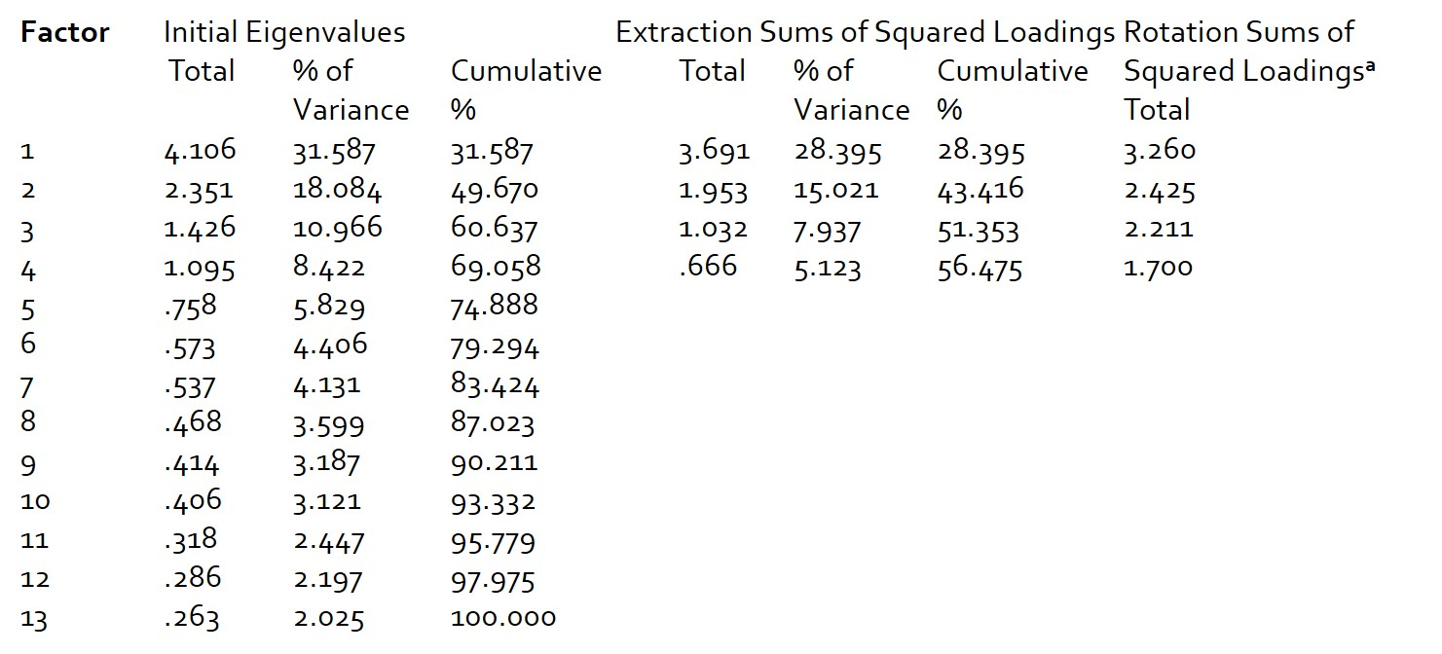
Output in the Four Component/Factor Structure
- Principal axis Factoring with Promax rotation
Total Variance Explained
FA will explain less variance than PCA as it explains the common variance
Same as PCA
Go back
Extraction Method: Principal Axis Factoring.
a. When factors are correlated, sums of squared loadings cannot be added to obtain a total variance.

Slide 24
Communalities in PCA and Principal axis Factoring
______________________________________
Initial Extraction
self-control: cpi 1.000 .732
self-acceptance: poi 1.000 .518
emotional inhibition: ecq 1.000 .698
benign control: ecq 1.000 .656
aggression control: ecq 1.000 .647
extraversion: neo 1.000 .808
agreeableness: neo 1.000 .704
positive affect: mpq 1.000 .671
negative affect: mpq 1.000 .693
neuroticism: neo 1.000 .746
depression control: cecs 1.000 .797
anxiety control: cecs 1.000 .674
self-regard: poi 1.000 .633
_____________________________________
Extraction Method: Principal Component Analysis.
R² Multiple correlation between cpi and other IVs
Reestimated through an iterative process
______________________________________
Initial Extraction
self-control: cpi .515 .629
self-acceptance: poi .309 .302
emotional inhibition: ecq .490 .554
benign control: ecq .470 .546
aggression control: ecq .350 .450
extraversion: neo .486 .785
agreeableness: neo .370 .521
positive affect: mpq .388 .435
negative affect: mpq .568 .629
neuroticism: neo .635 .741
depression control: cecs .532 .821
anxiety control: cecs .378 .419
self-regard: poi .447 .512
_____________________________________
Extraction Method: Principal Axis Factoring.
1= var due to 1+ var due to 2+ ….var due to 13

Slide 25
Correlation matrices
Component/Factor correlation matrix will resolve the issue of rotation
Component Correlation Matrix
Comp 1 2 3 4
nent
1 1.000 .423 -.251 .190
2 .423 1.000 -.042 -.048
3 -.251 -.042 1.000 -.291
4 .190 -.048 -.291 1.000
Factor Correlation Matrix
Factor 1 2 3 4
1 1.000 .517 -.312 .221
2 .517 1.000 -.047 -.112
3 -.312 -.047 1.000 -.333
4 .221 -.112 -.333 1.000
Extraction Method: Principal Component Analysis.
Rotation Method: Promax with Kaiser Normalization.
Observations
Some pairs are not correlated(2 & 3, -.047)
Other pairs are highly correlated (1&2, .517)
Presence of any correlation .3 or greater supports oblique rotation(Promax)
Extraction Method: Principal Axis Factoring.
Rotation Method: Promax with Kaiser Normalization.
Since factors are correlated we will investigate PCA and
Principal axis Factoring using use Promax rotation

Slide 26
Structure matrix in PCA and FA
- Four factor solution
Sample size Significance loading
200 .4
100 .55
50 .75
Correlation between variable and component
Component
1 2 3 4
neuroticism: neo -.843 -.403 .264 -.327
negative affect: mpq -.822 -.453 .153 -.159
self-regard: poi .770 .249 -.256 .334
self-acceptance: poi .687 .096 -.213 .151
aggression control: ecq .155 .776 .088 -.047
self-control: cpi .480 .768 -.085 -.311
agreeableness: neo .251 .747 -.182 .303
benign control: ecq .564 .736 -.019 -.153
depression control: cecs -.276 -.040 .886 -.184
emotional inhibition: ecq -.236 .063 .816 -.378
anxiety control: cecs -.132 -.110 .809 -.207
extraversion: neo .217 -.040 -.333 .895
positive affect: mpq .451 .169 -.201 .748
Factor
1 2 3 4
neuroticism: neo -.854 -.426 .287 -.293
negative affect: mpq -.787 -.471 .178 -.139
self-regard: poi .699 .288 -.282 .295
self-acceptance: poi .534 .173 -.230 .174
self-control: cpi .469 .739 -.074 -.292
benign control: ecq .540 .691 -.033 -.148
agreeableness: neo .327 .650 -.170 .209
aggression control: ecq .205 .648 .073 -.090
depression control: cecs -.290 -.050 .900 -.205
emotional inhibition: ecq -.253 .042 .727 -.376
anxiety control: cecs -.176 -.089 .640 -.232
extraversion: neo .279 -.045 -.343 .881
positive affect: mpq .470 .169 -.245 .553
Extraction Method: Principal Component Analysis.
Rotation Method: Promax with Kaiser Normalization.
Extraction Method: Principal Axis Factoring.
Rotation Method: Promax with Kaiser Normalization.
Observations
Since factors are correlated we will investigate FA
Ecq is cross loaded on both factors 1 and 2
Factor loading; .7 –strong, .5&.6 – Moderate, .3&.4 very modest indicator
Check eigen values

Slide 27
Factors in Four factor solution
Factor 1: Mental Health
Variable loading Remark
neuroticism: neo -.854 -vely correlated
negative affect: mpq -.787 -vely correlated
self-regard: poi .699 +vely correlated
self-acceptance: poi .534 +vely correlated
Factor 2: Emotional Control
Variable loading
self-control: cpi .739
benign control: ecq .691
agreeableness: neo .650
aggression control: ecq .648
Factor 3: Inhibition of Depression
Variable loading
depression control: cecs 0.9
emotional inhibition: ecq 0.727
anxiety control: cecs 0.64
Factor 4: Positive outgoingness
Variable loading
extraversion: neo 0.881
positive affect: mpq 0.553
Analysis in 4 factor Solution
Fourth factor has eigen value less than 1
One pair of factors correlation is more than .5
One variable “benign control” has substantial cross loadings
Factor 4 has only two variable in 13 variable analysis.
Check eigen values

Slide 28
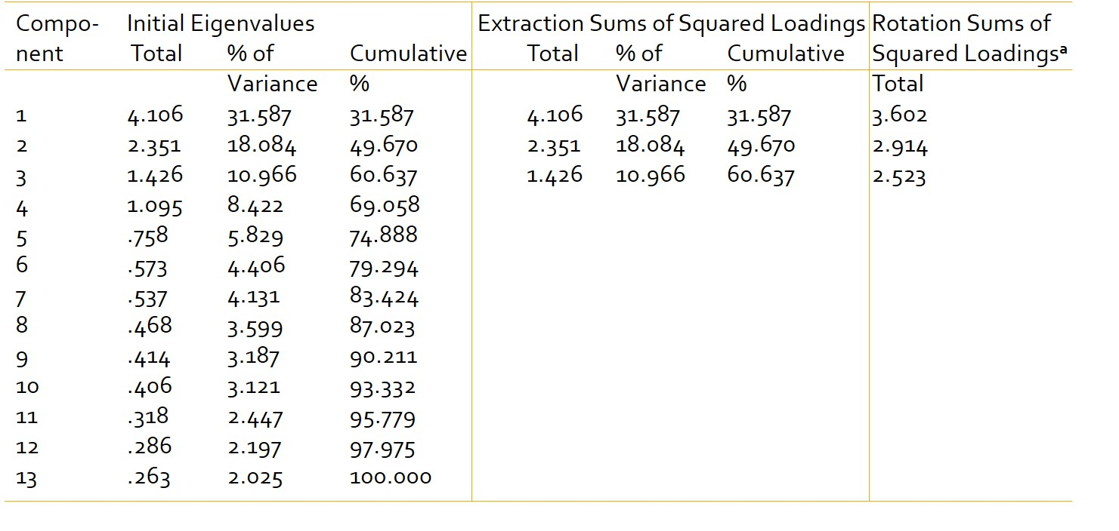
Three Component/Factor Structure
- Principal Components Analysis with Promax rotation
Total Variance Explained
more than that of FA
Extraction Method: Principal Component Analysis.
a. When components are correlated, sums of squared loadings cannot be added to obtain a total variance.

Slide 29
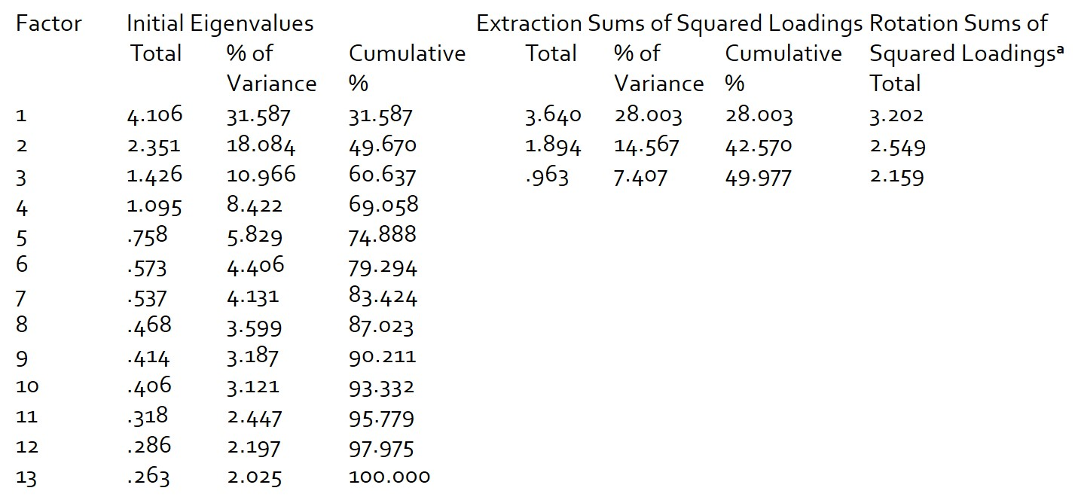
Three Component/Factor Structure
- Principal axis Factoring with Promax rotation
Total Variance Explained
Less than that of PCA
Extraction Method: Principal Axis Factoring.
a. When factors are correlated, sums of squared loadings cannot be added to obtain a total variance.

Slide 30
Communalities in PCA and Principal axis Factoring
- Three Factor Solution
Communalities
______________________________________
Initial Extraction
self-control: cpi 1.000 .713
self-acceptance: poi 1.000 .386
emotional inhibition: ecq 1.000 .696
benign control: ecq 1.000 .650
aggression control: ecq 1.000 .513
extraversion: neo 1.000 .549
agreeableness: neo 1.000 .432
positive affect: mpq 1.000 .535
negative affect: mpq 1.000 .646
neuroticism: neo 1.000 .726
depression control: cecs 1.000 .762
anxiety control: cecs 1.000 .674
self-regard: poi 1.000 .600
_____________________________________
Extraction Method: Principal Component Analysis.
Communalities
______________________________________
Initial Extraction
self-control: cpi .515 .687
self-acceptance: poi .309 .265
emotional inhibition: ecq .490 .576
benign control: ecq .470 .564
aggression control: ecq .350 .317
extraversion: neo .486 .433
agreeableness: neo .370 .282
positive affect: mpq .388 .407
negative affect: mpq .568 .580
neuroticism: neo .635 .709
depression control: cecs .532 .744
anxiety control: cecs .378 .433
self-regard: poi .447 .500
____________________________________
Extraction Method: Principal Axis Factoring.
Points to be noted
Most of the communalities in PCA exceeds .4 in comparison to that of PAF
It is because PCA explains 60% and PAF explains 49.977% of the variance

Slide 31
Correlation matrices
Component Correlation Matrix
__________________________________
Component 1 2 3
_________________________________
1 1.00 .297 -.339
2 .297 1.00 .025
3 -.339 .025 1.00
_________________________________
Factor Correlation Matrix
_______________________________
Factor 1 2 3
______________________________
1 1.000 .375 -.394
2 .375 1.000 .009
3 -.394 .009 1.000
______________________________
Extraction Method: Principal Component Analysis.
Rotation Method: Promax with Kaiser Normalization.
Extraction Method: Principal Axis Factoring.
Rotation Method: Promax with Kaiser Normalization.
Points to be noted
Components/factors 2 and 3 are uncorrelated
Two other pairs are sufficiently correlated which warrants oblique rotation

Slide 32
Structure matrix in PCA and FA
- Three factor solution
Component
1 2 3
neuroticism: neo -.822 -.460 .242
self-regard: poi .770 .311 -.237
negative affect: mpq -.723 -.539 .117
positive affect: mpq .715 .064 -.249
self-acceptance: poi .620 .208 -.179
extraversion: neo .601 -.205 -.407
self-control: cpi .215 .841 -.028
benign control: ecq .360 .794 .026
aggression control: ecq .081 .703 .091
agreeableness: neo .325 .615 -.204
depression control: cecs -.304 -.056 .869
emotional inhibition: ecq -.367 .089 .822
anxiety control: cecs -.198 -.074 .807
Factor
1 2 3
neuroticism: neo -.816 -.498 .264
self-regard: poi .702 .342 -.264
negative affect: mpq -.687 -.553 .151
positive affect: mpq .625 .117 -.258
extraversion: neo .539 -.135 -.365
self-acceptance: poi .512 .235 -.210
self-control: cpi .233 .821 -.037
benign control: ecq .363 .745 .003
aggression control: ecq .120 .553 .082
agreeableness: neo .339 .494 -.159
depression control: cecs -.331 -.065 .859
emotional inhibition: ecq -.380 .066 .745
anxiety control: cecs -.243 -.061 .653
Extraction Method: Principal Component Analysis.
Rotation Method: Promax with Kaiser Normalization.
Extraction Method: Principal Axis Factoring.
Rotation Method: Promax with Kaiser Normalization.
Points to be noted
PCA and FA both provides the same dimensional structure
Correlations from the PCA are substantially stronger
Let us focus on PAF and discuss the findings

Slide 33
Factors in Three factor solution
Factor 1: Positive Life Adjustment
Variable loading Remark
neuroticism: neo -0.816 -vely correlated
self-regard: poi 0.702 +vely correlated
negative affect: mpq -0.687 -vely correlated
positive affect: mpq 0.625 +vely correlated
extraversion: neo 0.539 +vely correlated
self-acceptance: poi 0.512 +vely correlated
Factor 2: Emotional Control
Variable loading
self-control: cpi 0.821
benign control: ecq 0.745
aggression control: ecq 0.553
agreeableness: neo 0.494
Subjects having higher score on this
factor tends to have better
emotional control
People who have higher score on this factor are more stable, confident, and positive in their attitude
Factor 3: Inhibition of Depression
Variable loading
depression control: cecs 0.859
emotional inhibition: ecq 0.745
anxiety control: cecs 0.653
Analysis of 3 factor Solution
Factor 1 is the combination of factor 1 and 4 in four factor solution
Subjects having higher score indicates higher inhibition of depression
Check eigen values

Slide 34
Which Solution to Accept
Why to Use Three factor solution
because
Three component/factor structure has overcome most
of the weaknesses of four factor solution
One remaining weakness is a little cross loading for “negative effect” in both analysis and for “agreeableness” in principal axis factor solution.

Slide 35
Which Solution to Accept
Researcher needs to decide still whether to report PCA or FA
PCA
FA
Provides somewhat stronger structure coefficients
Less cross loading
Most of communalities are greater than .4
Around 60% explained variance in PCA in comparison to 50% in FA may not be tangible benefit as FA explains only common variance
Researchers may opt to report findings of FA due to professional preference.
Should be preferred in developing test batter
Remarks
Choice of which extraction procedure to report does not affect the interpretation of the dimensional structure of variables
The weight may change in evaluating different dimensions in developing test battery

Slide 36
PCA/Factor Analysis with R Software
Illustration
Lawyers rating of state Judges
SN CONT ING DMNR DILG CEMG DECI PREP FAMI ORAL WRIT PHYS RTEN
1 5.7 7.9 7.7 7.3 7.1 7.4 7.1 7.1 7.1 7.7 8.3 7.8
2 6.8 8.9 8.8 8.5 7.8 8.1 8 7 8 7 7.8 7.4 8.5 8.7
3 7.2 8.1 7.8 7.8 7.5 7.6 5 8 5 8 7.3 8.5 7.9 7.8
4 6.8 8.8 8.5 8.8 8.3 8.5 7.5 7.5 8.4 5.3 8.8 8.7
--- ... … ... ... ... ... ... ... … ... ... ...
43 7.3 6.4 4.3 6.5 6.7 6.2 7.8 7.8 5.1 8.8 5.5 4.8
CONT Number of contacts of Lawyers with judge
ING Judicial integrity
DMNR Demeanor
DILG Diligence
CEMG Case-flow managing
DECI Prompt decisions
PREP Preparation for trial
FAMI Familiarity with Law
ORAL Sound oral ruling
WRIT Sound writing ruling
PHYS Physical ability
RTEN Worthy of retention

Slide 37
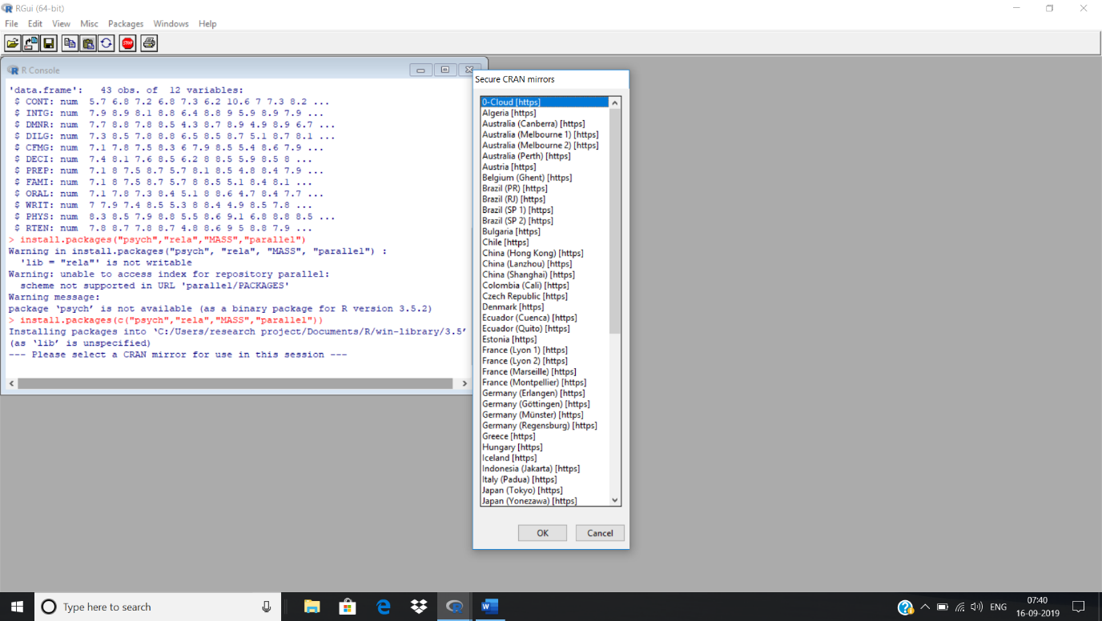
Install R Software Commands
Commands for PCA/FA
install.packages(c("psych","rela","MASS","parallel"))
--- Please select a CRAN mirror for use in this session
Press OK on the right screen
library(psych); library(rela); library(MASS); library(parallel)
Commands for GUI
install.packages(“meta”) # for GUI outputs
Library(meta)
Copy inbuilt data
data(USJudgeRatings)
str(USJudgeRatings)
'data.frame': 43 obs. of 12 variables:
$ CONT: num 5.7 6.8 7.2 6.8 7.3 6.2 10.6 7 7.3 8.2 ...
$ INTG: num 7.9 8.9 8.1 8.8 6.4 8.8 9 5.9 8.9 7.9 ...
$ DMNR: num 7.7 8.8 7.8 8.5 4.3 8.7 8.9 4.9 8.9 6.7 ...
$ DILG: num 7.3 8.5 7.8 8.8 6.5 8.5 8.7 5.1 8.7 8.1 ...
$ CFMG: num 7.1 7.8 7.5 8.3 6 7.9 8.5 5.4 8.6 7.9 ...
$ DECI: num 7.4 8.1 7.6 8.5 6.2 8 8.5 5.9 8.5 8 ...
$ PREP: num 7.1 8 7.5 8.7 5.7 8.1 8.5 4.8 8.4 7.9 ...
$ FAMI: num 7.1 8 7.5 8.7 5.7 8 8.5 5.1 8.4 8.1 ...
$ ORAL: num 7.1 7.8 7.3 8.4 5.1 8 8.6 4.7 8.4 7.7 ...
$ WRIT: num 7 7.9 7.4 8.5 5.3 8 8.4 4.9 8.5 7.8 ...
$ PHYS: num 8.3 8.5 7.9 8.8 5.5 8.6 9.1 6.8 8.8 8.5 ...
$ RTEN: num 7.8 8.7 7.8 8.7 4.8 8.6 9 5 8.8 7.9 ...

Slide 38
Testing Assumptions in PCA/Factor
Bartlett and KMO tests are available in rela package
and are computed using paf() function
Since CONT is not a rating variable we need to drop
Commands for KMO & Bartlett Test
test.usj <- paf(USJudgeRatings[,-1], eigcrit=1, convcrit=0.001)
USD <- as.matrix(USJudgeRatings[,-1])
test<-paf(USD, eigcrit=1, convcrit=0.001)
summary(test)
[This will give error message as data needs to be in matrix form]
[Converting data into matrix form ]
Output
$KMO
[1] 0.90651
$Bartlett
[1] 1322.4
To find p value for Bartlett test we will use psych function
Command cortest.bartlett(cor(USD), n=43)
Output
$chisq
[1] 1322.4
$p.value
[1] 1.9508e-240
$df
[1] 55

Slide 39
Testing Assumptions in PCA/Factor
Commands for Testing Positive Determinants
USDCOR<-cor(USD)
det(USDCOR)
Output
[1] 4.8474e-16

Slide 40
Extracting Components in PCA/Factor
PCA is computed using principal() function of psych package
General format of the function: principal(r, nfactors=, rotate=, scores=)
Command for PCA
pca<-principal(USDCOR,rotate="none")
pca
Output
Principal Components Analysis
Call: principal(r = USDCOR, rotate = "none")
Standardized loadings (pattern matrix) based upon correlation matrix
PC1 h² u2 (=1-h²) com
INTG 0.92 0.84 0.1565 1
DMNR 0.91 0.83 0.1663 1
DILG 0.97 0.94 0.0613 1
CFMG 0.96 0.93 0.0720 1
DECI 0.96 0.92 0.0763 1
PREP 0.98 0.97 0.0299 1
FAMI 0.98 0.95 0.0469 1
ORAL 1.00 0.99 0.0091 1
WRIT 0.99 0.98 0.0196 1
PHYS 0.89 0.80 0.2013 1
RTEN 0.99 0.97 0.0275 1
10.13 0.92
PC1
SS loadings 10.13
Proportion Var 0.92

Slide 41
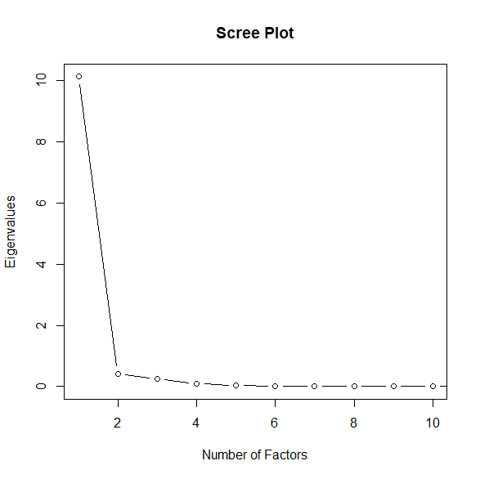
Scree Plot
Useful in deciding the number of components to extract
Commands:
plot(pca$values, type="b", xlim=c(1,10), main="Scree Plot", xlab="Number of Factors", ylab="Eigenvalues")
Output
Observation
Scree plot suggest that one component is appropriate in summarizing the data

Slide 42
Rotating Principal Components
Commands:
pcamodel1<-principal(USDCOR, nfactor=2, rotate="varimax")
pcamodel1
Output
Principal Components Analysis
Call: principal(r = USDCOR, nfactors = 2, rotate = "varimax")
Standardized loadings (pattern matrix) based upon correlation matrix
RC1 RC2 h2 u2
INTG 0.48 0.87 0.98 0.0164
DMNR 0.47 0.87 0.97 0.0252
DILG 0.81 0.54 0.95 0.0531
CFMG 0.88 0.45 0.97 0.0312
DECI 0.89 0.43 0.97 0.0282
PREP 0.82 0.56 0.98 0.0232
FAMI 0.81 0.55 0.96 0.0405
ORAL 0.77 0.63 0.99 0.0091
WRIT 0.77 0.62 0.98 0.0196
PHYS 0.79 0.44 0.82 0.1779
RTEN 0.70 0.70 0.98 0.0176
RC1 RC2
SS loadings 6.30 4.26
Proportion Var 0.57 0.39
Cumulative Var 0.57 0.96
Proportion Explained 0.60 0.40
Cumulative Proportion 0.60 1.00

Slide 43
Principal Components Scores
Commands
Output
PC1
AARONSON,L.H. -0.185798
ALEXANDER,J.M. 0.746987
ARMENTANO,A.J. 0.070477
BERDON,R.I. 1.135876
BRACKEN,J.J. -2.158621
BURNS,E.B. 0.766941
pcas<-principal(USD, nfactors=1, scores=TRUE)
head(pcas$scores)
To Examine Relationship between the number of contacts occurring between a lawyer and a judge and their evaluation of the judge(INTG vs PCScores)
Commands: cor.test(USJudgeRatings$INTG, pcas$scores)
Output
cor.test(USJudgeRatings$INTG, pcas$scores)
Pearson's product-moment correlation
data: USJudgeRatings$INTG and pcas$scores
t = 14.9, df = 41, p-value <2e-16
alternative hypothesis: true correlation is not equal to 0
95 percent confidence interval: 0.85351 - 0.95526
sample estimates: cor = 0.91842

